Slide 1

WriteDown
Mengmeng Liu,Yangling Hu, Ruifeng Zhu, Yiheng Jiang

Slide 2
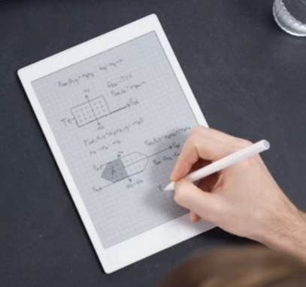
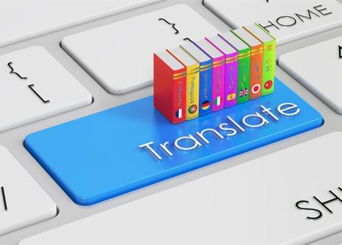


What is WriteDown?

Slide 3


Why WriteDown？
ECO
Better understanding
Save time

Slide 4
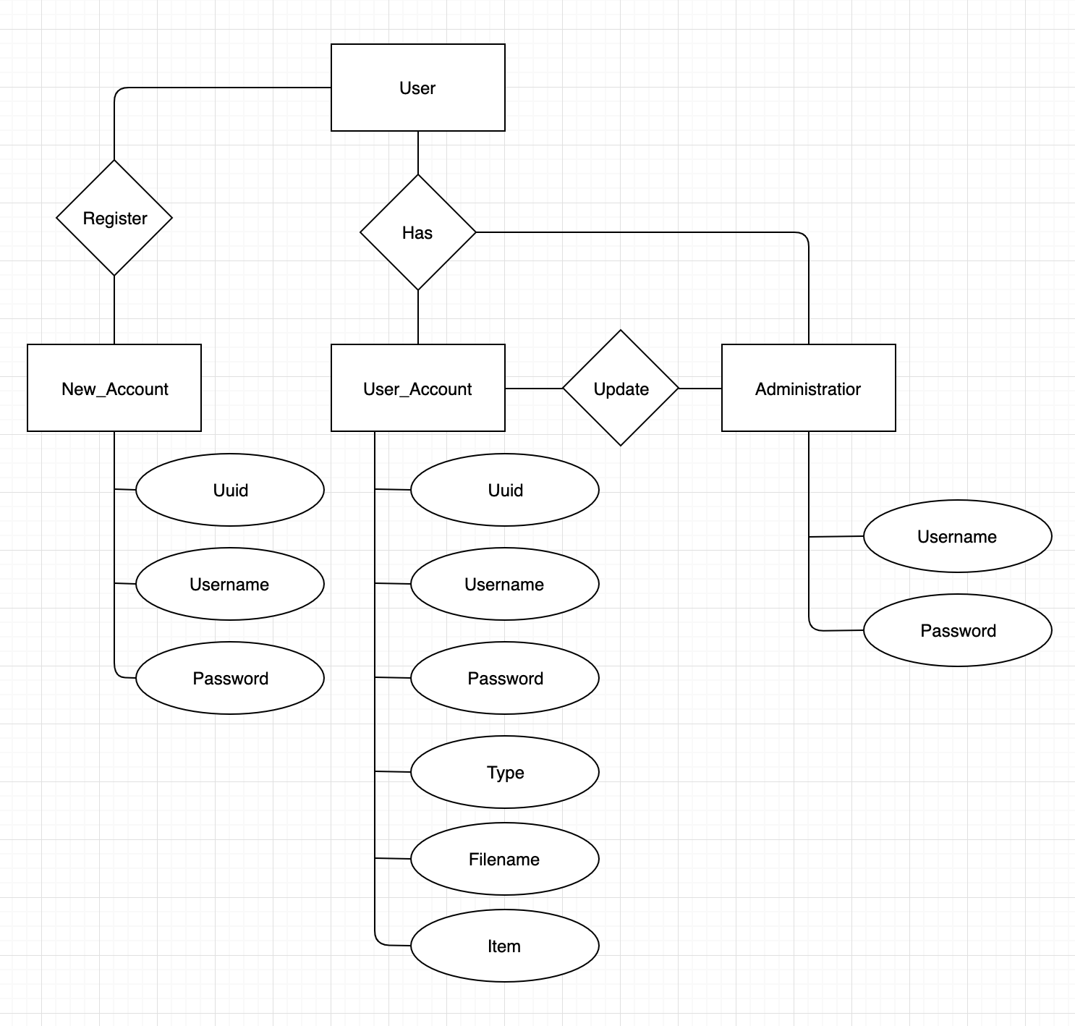
User/Adminstrator subsystem
Goal: 1. For new user to register our application.2.For Administrator to view, delete, ban users.
Technologies used: Android studio, Java ,SQLite Database.

Slide 5
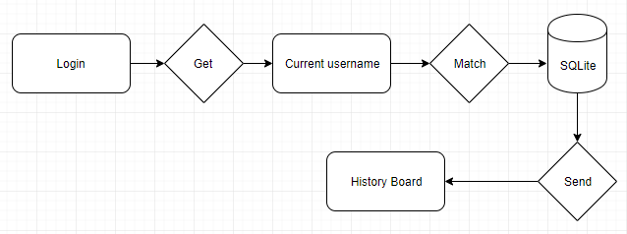
History Board subsystem
Goals: List the files which were saved by user. Easy for the review of the class.

Slide 6
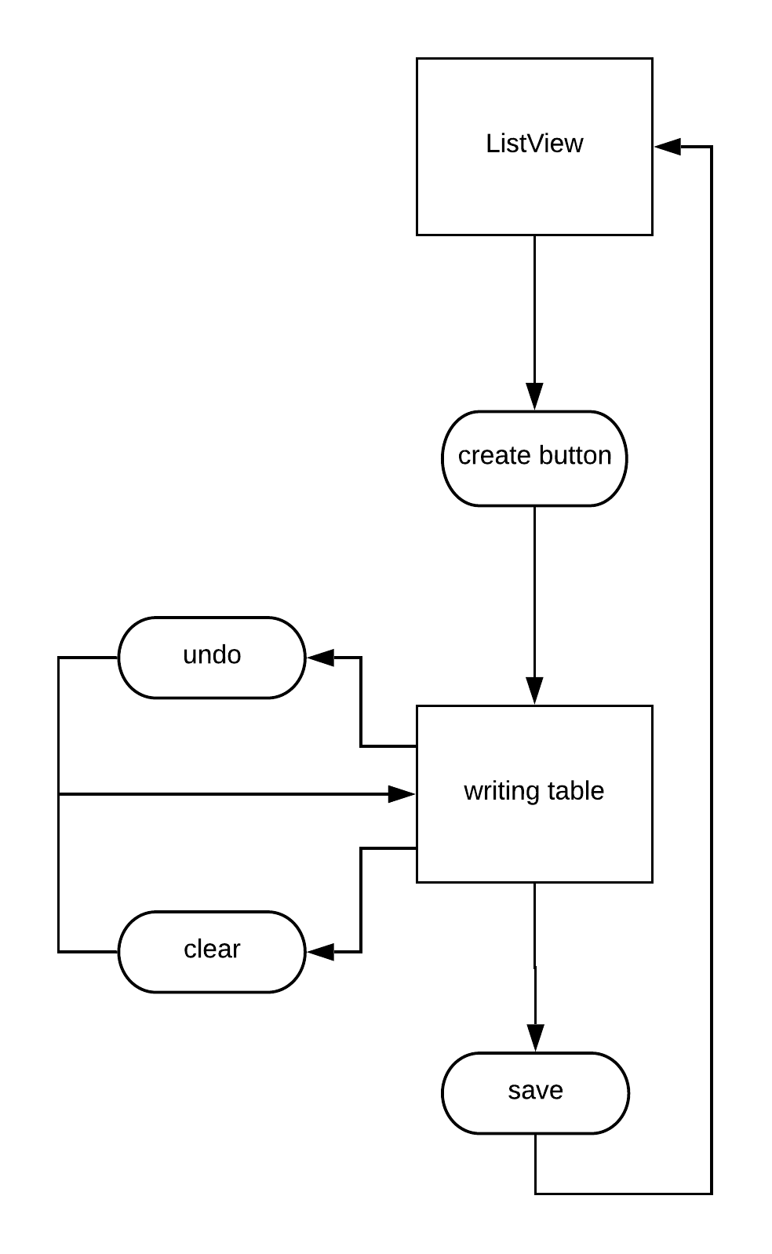
WritingTable
Goal: Create a canvas for the users to use. And the users can save the canvas as image. and clear the canvas. Also can delete a single stroke(undo).
Techonology: Android studio in Java.

Slide 7
OCR Recognize/image save
Goal: Recognize text from image,connect recognized text output as string for translate，save translated text as image as screen shot.
Techonology: Android studio in Java.
Libraries: Google vision library,java,util

Slide 8
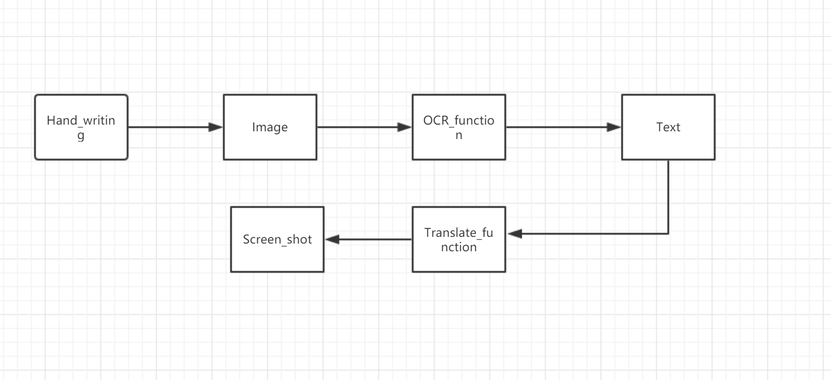
Process model

Slide 9
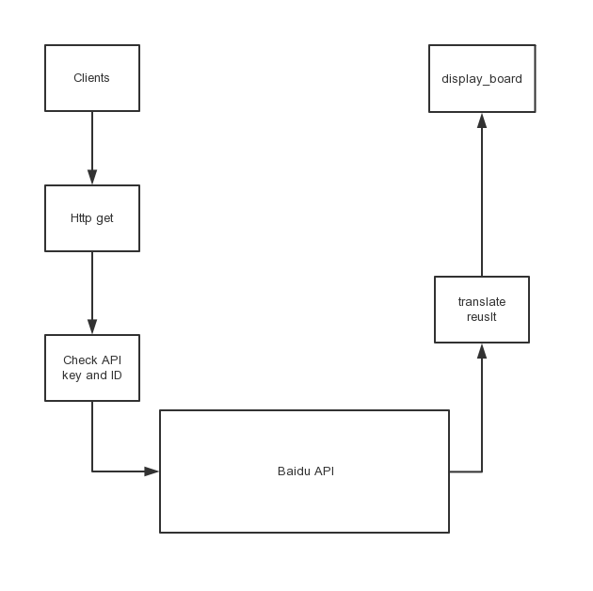
Baidu translation API
Goal: Get the text from the OCR API, send the request to the baidu translation API, get the translation result, and then send the result to the listview
Programming language: Java in android studio
Libraries: java.util, Baidu translate， Google Gson.

Slide 10
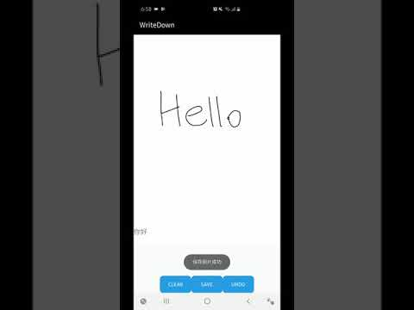
WriteDown(Demo)

Slide 11
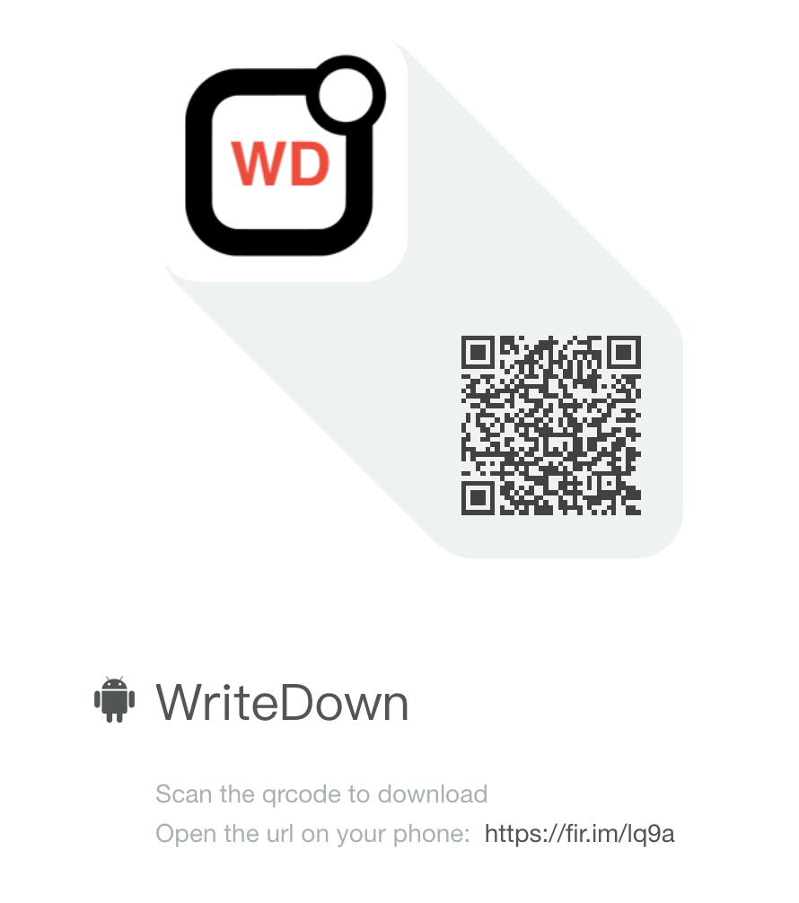
Thank you for your time!
Try it!

